Slide 1
Spring Framework: Spring Fundamentals
Default and Custom Event Handling

Slide 2
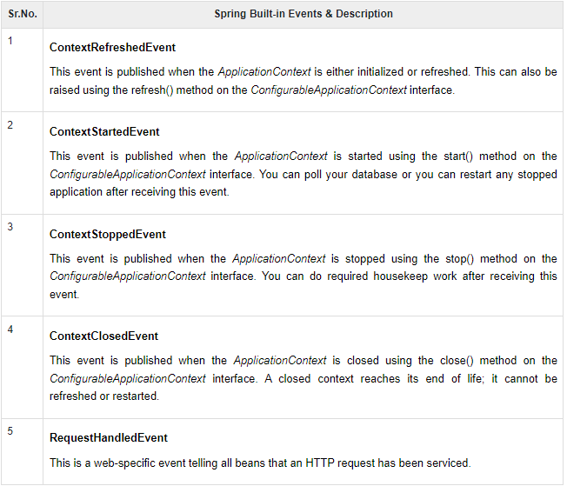
Spring Built-in Events

Slide 3

Assisted Practice
Spring Built-in Events

Slide 4
Publishing and Consuming Custom Events

Slide 5
Assisted Practice
Spring Custom Events

